Slide 1

Delta-8-THC:
Emerging Substance Trend
Itamar Zmora, BS Candidate
Intern, PreventionFIRST!

Slide 2

Objectives
Understand the key Delta-8 health effects
Recognize how Delta-8 has changed over time in the US, and who is likely to use the substance
Examine how and where Delta-8 is marketed and sold
Examine the stance of government agencies on the substance
Identify community level actions

Slide 3

Background-THC
Main psychoactive ingredient in cannabis products
  One of two main active compounds, alongside CBD
Taken for perceived positive effects: relaxation, euphoria, pain relief
Negative effects: anxiety, paranoia, short-term memory loss
Many varieties
  Delta-9-THC (most common)
  Delta-8-THC
  Delta-10-THC (new trend)

Slide 4
Delta-9 vs Delta-8:
What’s the difference?
Delta-9
Delta-8
Most THC in cannabis plants is Delta-9
  Most THC products are Delta-9
Delta-9 causes a greater reaction than Delta-8
Delta-8 is very rare in nature
Chemical difference is small—a single double-bond
Body detects the difference
4

Slide 5
Human Body:
Endocannabinoid System
Presynaptic Neuron
Enzyme
CB Receptor
Naturally produced cannabinoids(CB)
  N-arachidonoylethanolamine (anandamide, AEA)
  2-arachisonoylglycerol (2-AG)
Receptors
  CB1
  CB2
Endocannabinoids produced in postsynaptic neuron
  Lower activity of presynaptic neuron
Broken down by enzymes after use
Endocannabinoids
Postsynaptic
Neuron

Slide 6
Cannabinoids and Addiction
Endocannabinoids functions
  Mood, sleep, appetite, memory, REWARD
Delta-9 binds to CB1 and CB2
CBD prevents cannabinoids from being broken down
CB1 receptors highly concentrated in brain’s reward center
  Prevents stopping of dopamine release

Slide 7
Cannabinoids and Addiction
Delta-8
Delta-8 binds better to CB2
  Does not bind well to CB1
Less pronounced neurological response
Delta-8 has lesser effect
  “Diet Weed”

Slide 8
Delta-8 Legality
United States Agricultural Improvement Act of 2018
  “2018 Farm Bill”
  Legalized and defined hemp products
What is hemp?
  Cannabis sativa
  ≤0.3% Delta-9 by dry weight
Delta-8 unaccounted for, because it is very rare in nature
  No regulation!

Slide 9
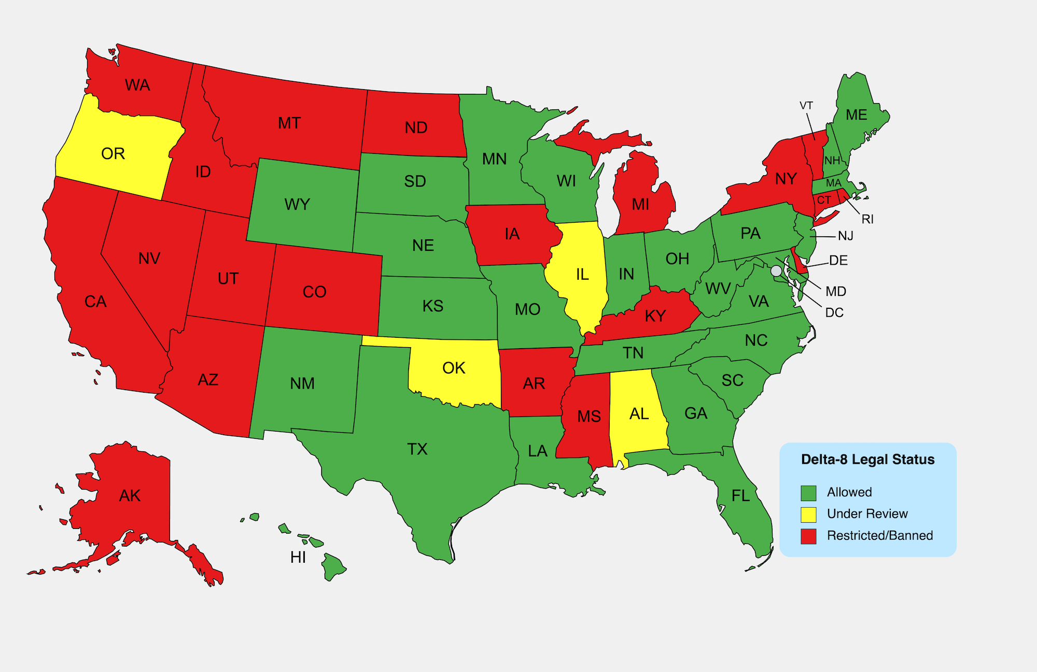
State-by-state legality
Ohio-Legal
Indiana-Legal
Kentucky-Illegal
https://cbdoracle.com/news/policy/delta-8-thc-legal/
Legality as of March 2022, updates monthly

Slide 10
Consumption Methods
Edibles (most common)
  Gummies (most common edibles)
  Flowers
  Chocolate and other food items
Vapes
Joints (smokeable form)
Loose buds (not common)

Slide 11
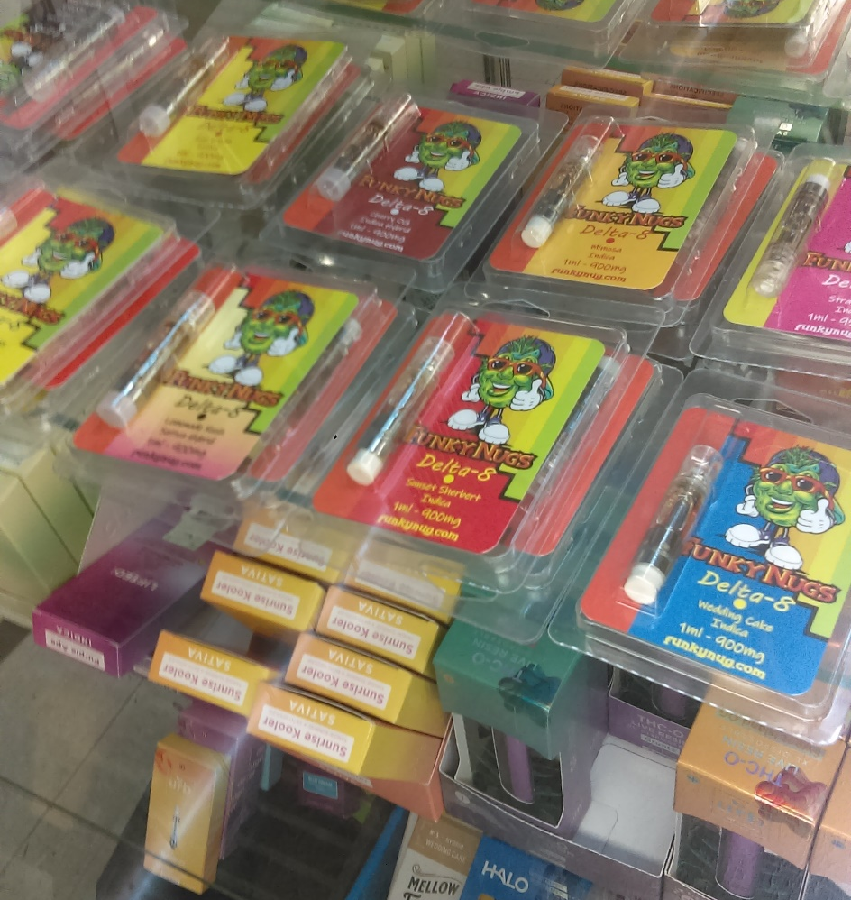
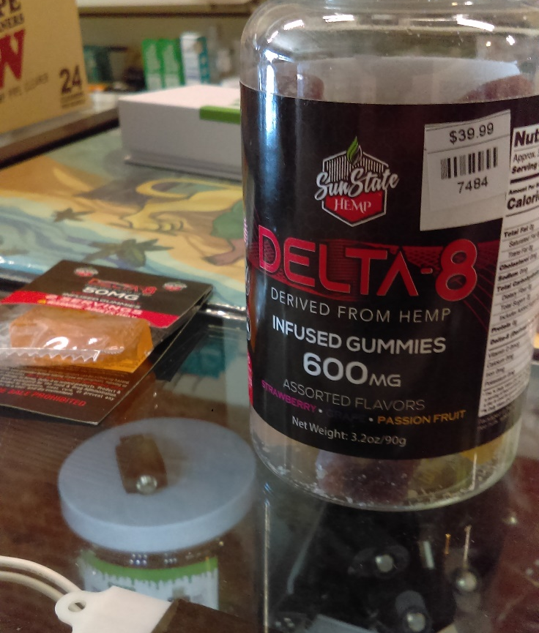
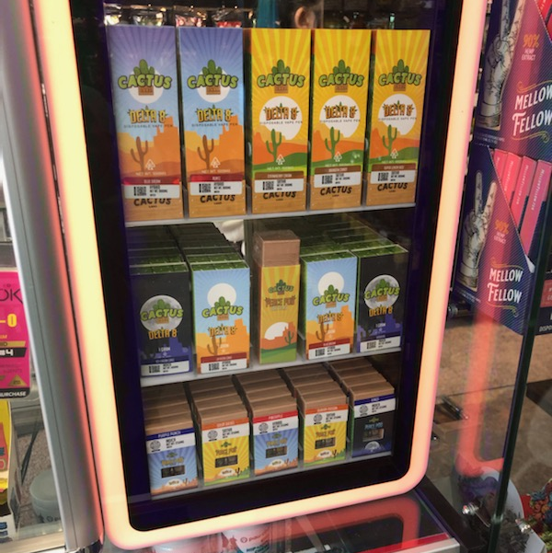
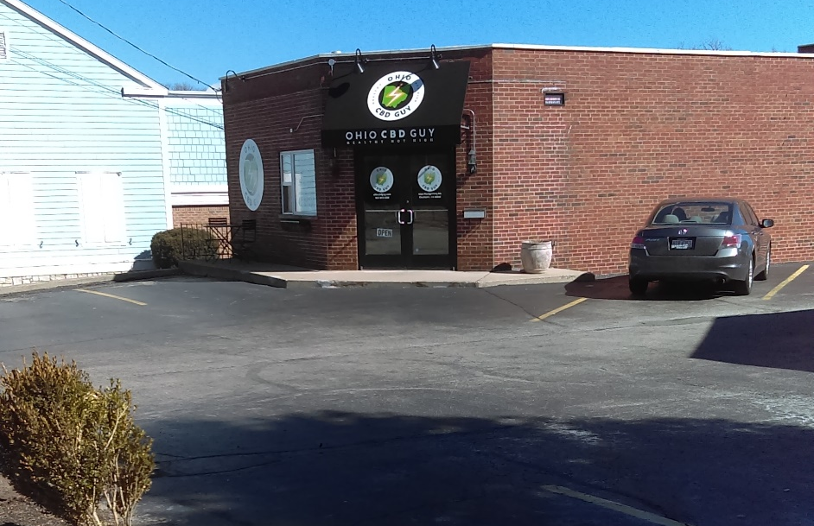
Where is it sold?
Vape stores
CBD stores
Gas stations/ Convenience stores

Slide 12
Environmental Scans
Hamilton County, OH
March/April 2022
Twelve locations so far (there are more)
  Most small businesses
    Vape shop or CBD store
Two-thirds are single-location businesses

Slide 13
Environmental Scans
Accessibility
In the vicinity of (within 1000 feet)
  Bar-Liquor Store (83%)
  Church (67%)
  School (50%)
  Playground/Recreational Facility (33%)
Kid-Friendly Products | 5
Sidewalk, Bus Stop, Bike Path | 11
Near UC* | 6
*West McMillan Street has an especially high density, including at least two locations that were not visited.

Slide 14
Environmental Scans
Products
Gummies 91.7%
Flavored Vape Liquid 83%
Edibles 58%
Loose Buds 50%
Other 50%
  oils, syrups, flowers, tinctures, balms, seltzers
Pre-Rolled Joints 41.7%
Lollipops 8%

Slide 15
Environmental Scans
Advertisement and Product Placement
3 locations had warnings about harmful side-effects
5 locations did not have packaging indicating the amount of THC present
In-store advertisement
  CBD 41%
  Delta-8 16.7%
Where Delta-8 Products are Located
Open Display | 1
Displayed in Front | 1
On Wall Behind Counter | 2
Assistance Required for Costumers | 8
In and Enclosed Display | 10

Slide 16
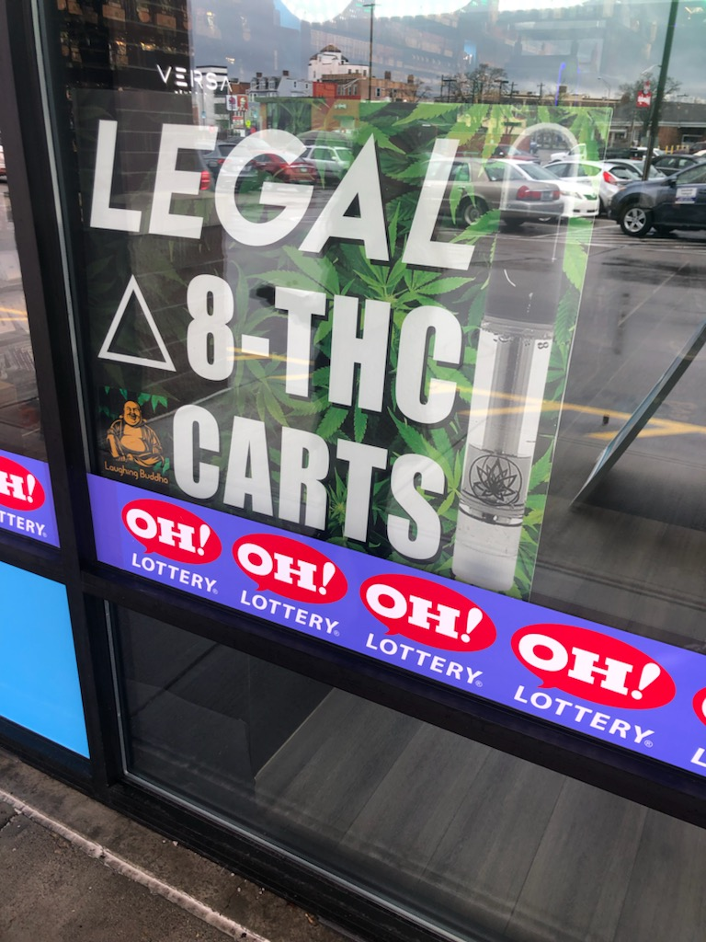
Advertisement
A vague, non-FDA warning might be on the product.

Slide 17
Delta-8 Manufacturing and Market Flood
CBD Delta-8 Profit
Farm Bill passed, oversupply of CBD from hemp
  Late 2019, early 2020
  CBD stocks converted to Delta-8 as market compensation
  Delta-8 unregulated
DEA memo, August 2020
  All synthetic THC is still Schedule I
  BUT! Delta-8 does occur in nature, so not, in itself, synthetic
Farm Bill Passes

Slide 18
Delta-8 Manufacturing and Market Flood
Because Delta-8 occurs so rarely in nature, most Delta-8 on the market is synthesized from CBD.
The process involves chemicals like sulfuric acid and boron fluoride.
All chemicals used in the synthesis process can be publicly purchased in small amounts.

Slide 19
Delta-8 Dangers
Remember!
Delta-9: Regulated
Delta-8: New, Unregulated
Regular Delta-8, same effect as Delta-9, but milder
  Remember receptors?
  Consuming too much Delta-8 is like consuming too much Delta-9!
  Vomiting, hallucinations, balance problems, memory problems
  At especially high doses, loss of consciousness
Increased Danger
  Chemically modified Delta-8
  By-products
CASE STUDY:
  38-year-old female with sleeve gastrectomy
  Used Delta-8 gummies to sleep better
  Developed Cannabinoid Hyperemesis Syndrome

Slide 20
Modified Delta-8
Delta-8 can be chemically modified in the production process
Higher affinity to CB1 receptors
Up to 40 times as potent
CASE STUDY:
  2-year-old girl
  Consumed 225 mg of Delta-8 gummies
  Developed Encephalopathy
  Airlifted to hospital and intubated
  Took two and a half days to fully recover
  Gummies contained modified Delta-8, which was detected in her urine and blood plasma

Slide 21
By-products
Produced unintentionally during production
Not always removed
  No regulation
Novel Psychoactive Substances (NPS)
  “Novel” = “New”
  Often understudied, or not studied at all
  DEA emergency bans
Side Effects:
  Delusions, paranoia, anxiety, tachycardia (fast heartbeat), hypertension (high blood pressure)
  Neurological effects similar to Psychosis and Schizophrenia

Slide 22
Health Complications from Delta-8
FDA Stats
104 FDA reports
66% from Delta-8 edibles consumption
8% pediatric cases
55% emergency medical aid or intervention
Poison control center cases, since Jan. 1, 2021
2362 Delta-8 exposure cases
70% hospitalization
  8% of these sent to critical care
40% unintentional exposure, majority of these pediatric
Total 41% pediatric, one death reported

Slide 23
Detecting Delta-8
No field tests good enough to detect Delta-8
Standard nine-panel test and other common tests detect Delta-8 and Delta-9 together
In labs, multistep process is possible
  Bodily fluid sample
  Liquid chromatography to separate THC from the sample
  Mass spectroscopy to identify presence of Delta-8 (and Delta-9)

Slide 24
Usage Trends
So far, there are no exclusive trends to Delta-8 use.
Most at risk communities:
  Low-income
  Youth
  Minority communities
Why?
  “Stress reduction hypothesis” for cannabis products
  Lack of Education

Slide 25
Summary
Delta-8-THC is a form of THC not often found in nature.
It is synthesized from hemp CBD and sold without FDA regulation. This is possible because of several legal loopholes.
Its legality varies by state, and it is currently legal in Ohio and Indiana.
The endocannabinoid system regulates many functions in the nervous system.
THC can bind to endocannabinoid receptors, causing physical and psychological effects.

Slide 26
Summary
Delta-8 can be consumed through many methods, but the most common way is through edibles.
Delta-8 is available at vape and CBD stores and is starting to appear in gas stations.
Modified Delta-8 and synthetic side products can have different and more intense effects than Delta-8 usually does.
Children are far more at risk from negative effects and accidental exposure.
Field tests for Delta-8 are still in development.

Slide 27
Next Steps
Know where Delta-8 is sold
  Environmental Scans
  Ease of Access
Stay up-to-date on trends
  FDA
  CDC
  Journal of Cannabis Research (very high-level academic language)
Speak to public leaders
  Watch for legal changes
  Provide Current Information
Help educate your community
  NO SCARE TACTICS!!!!!
  “Know it enough to explain it to your grandma”

Slide 28
Questions?

Slide 29
Citations
Akpunonu, P., Baum, R. A., Reckers, A., Davidson, B., Ellison, R., Riley, M., Trecki, J., & Gerona, R. (2021). Sedation and acute encephalopathy in a pediatric patient following ingestion of delta-8-tetrahydrocannabinol gummies. American Journal of Case Reports, 22. https://doi.org/10.12659/ajcr.933488
Bilel, S., Tirri, M., Arfè, R., Ossato, A., Trapella, C., Serpelloni, G., Neri, M., Fattore, L., & Marti, M. (2020). Novel halogenated synthetic cannabinoids impair sensorimotor functions in mice. NeuroToxicology, 76, 17–32. https://doi.org/10.1016/j.neuro.2019.10.002
Bossong, M. G., Mehta, M. A., van Berckel, B. N., Howes, O. D., Kahn, R. S., & Stokes, P. R. (2015). Further human evidence for striatal dopamine release induced by administration of ∆9-tetrahydrocannabinol (THC): Selectivity to limbic striatum. Psychopharmacology, 232(15), 2723–2729. https://doi.org/10.1007/s00213-015-3915-0
Centers for Disease Control and Prevention. (2021, September 14). Han archive - 00451. Centers for Disease Control and Prevention. Retrieved 2021, from https://emergency.cdc.gov/han/2021/han00451.asp
Chan-Hosokawa, A., Nguyen, L., Lattanzio, N., & Adams, W. R. (2022). Emergence of Delta-8 Tetrahydrocannabinol in DUID Investigation Casework: Method Development, Validation and Application. Journal of Analytical Toxicology, 46(1), 1–9. https://doi.org/https://doi.org/10.1093/jat/bkab029
Cornwell, A. M. (2022, April 2). Where is delta-8 THC available or banned? (map of states). CBD Oracle. Retrieved 2021, from https://cbdoracle.com/news/policy/delta-8-thc-legal/
Eight things to know about delta-8. Working Partners. (2021, November 30). Retrieved 2021, from https://www.workingpartners.com/eight-things-to-know-about-delta-8/
Erickson, B. E. (2021, August 30). Cen.acs.org. Retrieved 2021, from https://cen.acs.org/biological-chemistry/natural-products/Delta-8-THC-craze-concerns/99/i31
FDA. (2022, March 18). 5 things to know about delta-8 tetrahydrocannabinol – delta-8 THC. U.S. Food and Drug Administration. Retrieved 2022, from https://www.fda.gov/consumers/consumer-updates/5-things-know-about-delta-8-tetrahydrocannabinol-delta-8-thc
Johnson-Arbor, K., & Smolinske, S. (2021). The current state of delta-8 THC. The American Journal of Emergency Medicine. https://doi.org/10.1016/j.ajem.2021.06.066

Slide 30
Citations
Kiselak, T. D., Koerber, R., & Verbeck, G. F. (2020). Synthetic route sourcing of illicit at home cannabidiol (CBD) isomerization to psychoactive cannabinoids using ion mobility-coupled-LC–MS/MS. Forensic Science International, 308. https://doi.org/10.1016/j.forsciint.2020.110173
Kruger, J. S., & Kruger, D. J. (2022). Delta-8-THC: Delta-9-THC’s nicer younger sibling? Journal of Cannabis Research, 4(1). https://doi.org/10.1186/s42238-021-00115-8
Raypole, C. (2019, May 17). Endocannabinoid system: A simple guide to how it works. Healthline. Retrieved 2022, from https://www.healthline.com/health/endocannabinoid-system
Reboussin, B. A., Ialongo, N. S., Green, K. M., Furr-Holden, D. M., Johnson, R. M., & Milam, A. J. (2018). The impact of the urban neighborhood environment on marijuana trajectories during emerging adulthood. Prevention Science, 20, 270–279. https://doi.org/10.1007/s11121-018-0915-4
Rosenthal, J., Howell, M., Earl, V., & Malik, M. (2021). Cannabinoid hyperemesis syndrome secondary to delta-8 THC use. The American Journal of Medicine, 134(12), e582–e583. https://doi.org/10.1016/j.amjmed.2021.06.048
Uhl, G. R., Koob, G. F., & Cable, J. (2019). The neurobiology of addiction. Annals of the New York Academy of Sciences, 1451(1), 5–28. https://doi.org/10.1111/nyas.13989
van Hell, H. H., Jager, G., Bossong, M. G., Brouwer, A., Jansma, J. M., Zuurman, L., van Gerven, J., Kahn, R. S., & Ramsey, N. F. (2011). Involvement of the endocannabinoid system in reward processing in the human brain. Psychopharmacology, 219(4), 981–990. https://doi.org/10.1007/s00213-011-2428-8
Wiebelhaus, J. M., Poklis, J. L., Poklis, A., Vann, R. E., Lichtman, A. H., & Wise, L. E. (2012). Inhalation exposure to smoke from synthetic “marijuana” produces potent cannabimimetic effects in mice. Drug and Alcohol Dependence, 126(3), 316–323. https://doi.org/10.1016/j.drugalcdep.2012.05.034

